Slide 1

Governing Board Meeting
The meeting will begin shortly

Slide 2
Governing Board Meeting
Please note, this meeting is being recorded. We will begin the recording now.
March 14, 2025

Slide 3
Welcome
Declaration of Quorum
Additions to the Agenda
Approval of December Meeting Minutes

Slide 4
Agenda
Bylaws - Review and Revisions - Mr. Ross Goldstein
  Board Action Required
Center Output - Dr. Ann Kellogg and Dr. Angela Henneberger
Legislation - Mr. Ross Goldstein
Data Inventory - Ms. Molly Abend
  Board Action Required
Project Applications and Updates - Dr. Angela Henneberger
Old Business
  U.S. Census Bureau Post Secondary Education Outcomes (PSEO) Update
  Research Agenda Annual Review Process
  AIB Agreement for System Access to Analyze Outcome Measures
  DSSP Contractor Selected
New Business
Closed Session
Closing

Slide 5
Governing Board Bylaws - Review and Revisions

Slide 6
Review of Bylaws
Overview
Proposed Changes
Vice-Chair
Action Item: Board Review

Slide 7
Appointment of Vice-Chair
1 | Chancellor of the University System | 2025
2 | Secretary of Juvenile Services | 2026
3 | Secretary of Higher Education* | 2027
4 | State Superintendent of Schools | 2028
5 | Secretary of Labor | 2029
6 | Secretary of Human Services | 2030

Slide 8
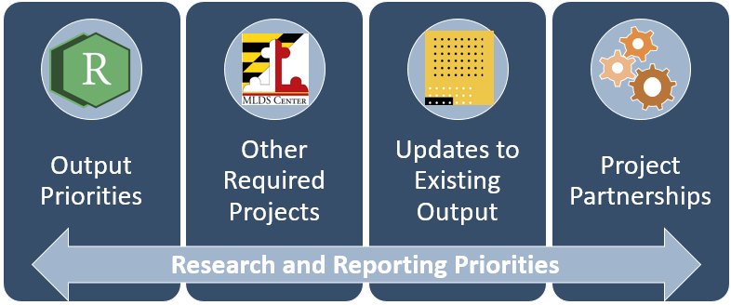
Center Output
Annual Priorities, 2024-2025: Update

Slide 9
Reporting Services Priorities, 2024-2025
Collection Exploration NonCredit Completions Microsoft Data and Other Licenses Five & Ten-Year Out Reports High School, Associate’s, Bachelor’s, GED, & Apprenticeship DJS - Discharged Youth Report Updates Brain Gain & Working While in College College-Going by Service Area and Carnegie Classification Required Annual Output Reports (2) Career Preparation Expansion Act Progress on Preparation and Diversity of New Teachers & Teacher Candidates Dashboards (4) Dual Enrollment, Foster Care, Homeless, & FAFSA Completion | Required Annual Output Con’t Tables & Other Output DHS: Foster Care JCR (2) DJS: Data Resource Guide (4) DLS: Dual Enrollment (2) MSDE: Perkins (CTE), Special Education (IDEA), & TPAR/APAR (3) Labor: Apprenticeship & LACES (OCTAE) (2) College-Specific: College Wage Outcomes (4) Community College Metrics (16) TPAR, CAEP, & AAQEP (21) Computer Science for All GWDB & CTE Committee (TBD) Behavioral Health, Clearinghouse and MAEF (TBD) HB 1244 (TBD) Correctional Education (TBD) ENOUGH Act, State Plan and KPIs (TBD) | Dashboard Refresh Maryland Public High School Graduates: College and Workforce Outcomes Maryland College Graduates Employed as Public School Teachers New Dashboards Educator Preparation Non-Degree Pathways for High School Graduates High School Financial Aid Expansion: Promise Dual Enrollment Expansion Credits and Courses Degree by Age 25 Data Requests
Planned
Tentative
Completed
In-Progress

Slide 10
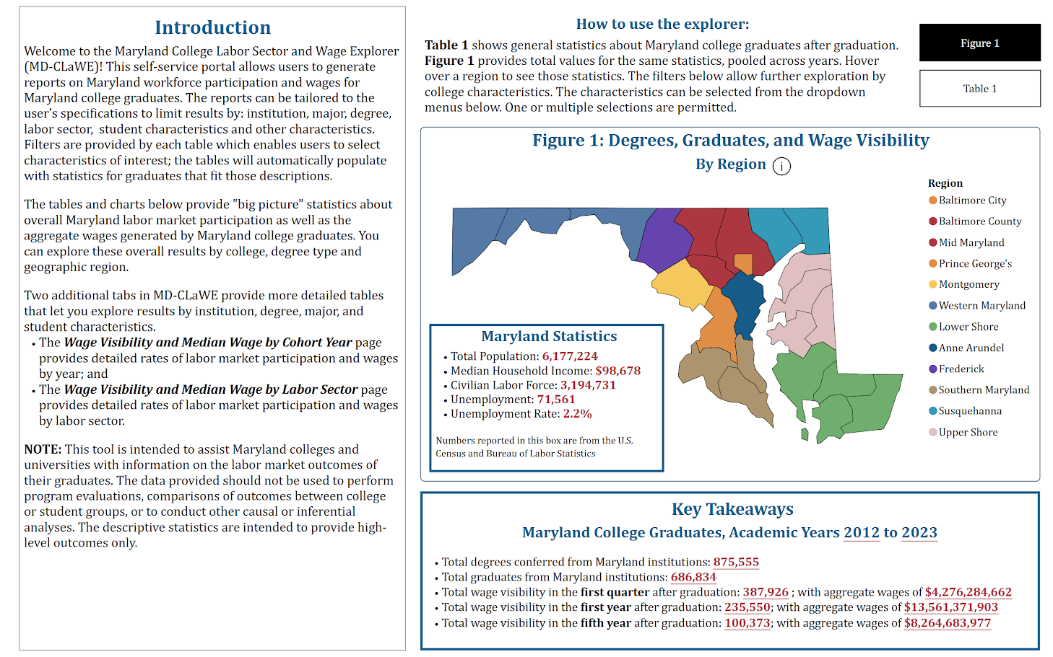
Maryland College Labor Sector and Wage Explorer (MD-CLaWE)

Slide 11
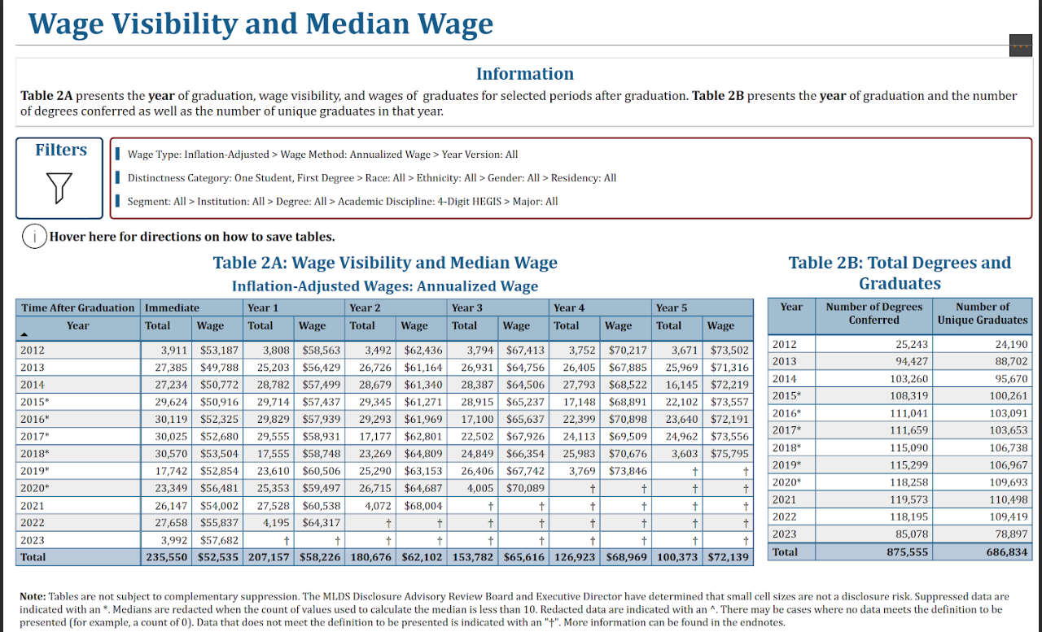
Maryland College Labor Sector and Wage Explorer (MD-CLaWE)

Slide 12
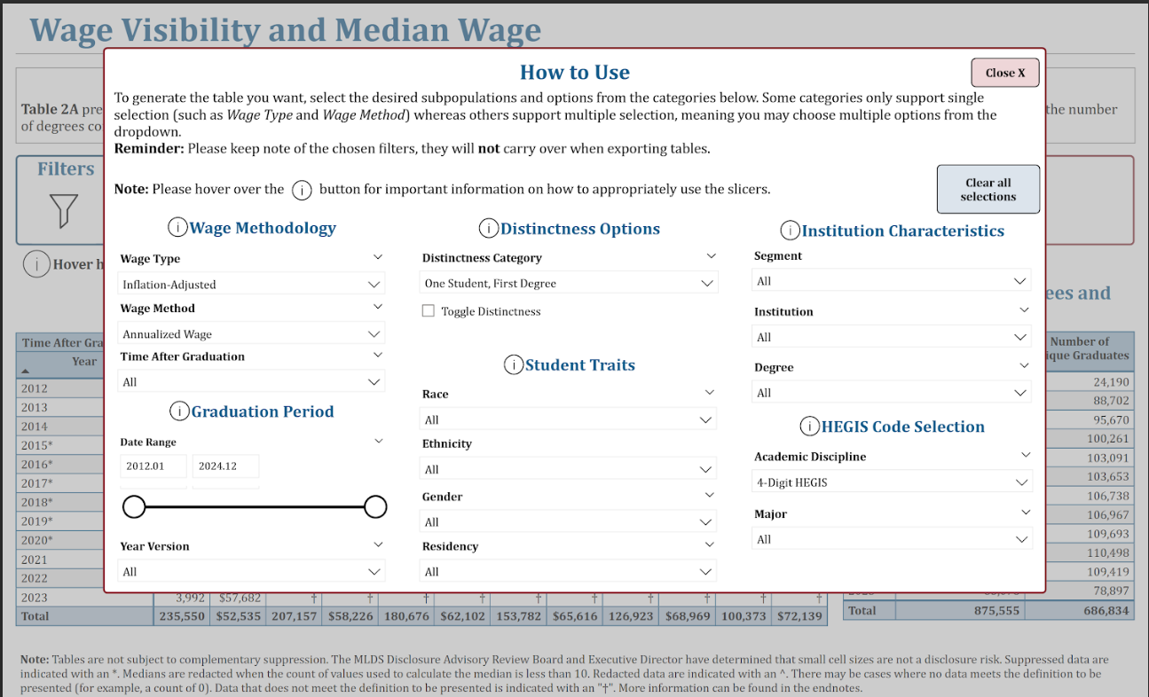
Maryland College Labor Sector and Wage Explorer (MD-CLaWE)

Slide 13
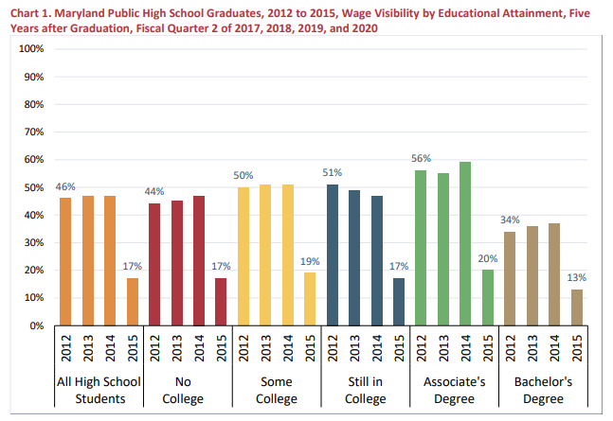
Career Preparation Expansion Act, Supplement
MLDS Center. (2022). Differences in Five Year Outcomes for High School Graduates: Wages and Wage Visibility Pre and Post COVID-19. A Supplement to the Annual Career Preparation Expansion Act Report on the Workforce Outcomes of Maryland Public High School Graduates to the Governor and General Assembly. Baltimore, MD: Maryland Longitudinal Data System Center.

Slide 14
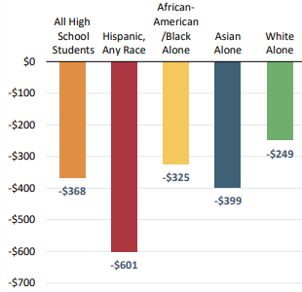
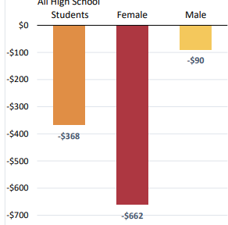
Career Preparation Expansion Act, Supplement
Overall quarterly median wages declined $368 from prior quarters
Quarterly median decrease varied
  $90 Males
  $662 Females
  $249 Whites
  $601 Hispanic
MLDS Center. (2022). Differences in Five Year Outcomes for High School Graduates: Wages and Wage Visibility Pre and Post COVID-19. A Supplement to the Annual Career Preparation Expansion Act Report on the Workforce Outcomes of Maryland Public High School Graduates to the Governor and General Assembly. Baltimore, MD: Maryland Longitudinal Data System Center.

Slide 15
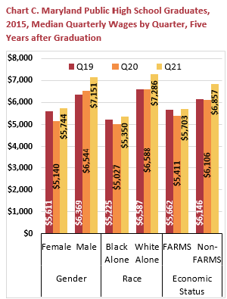
Career Preparation Expansion Act, Supplement
High school graduates who remained in labor market January to June 2020, 6 months later . . .
  Males, Whites and Non-FARMS had median quarterly wages remain flat and then increase $800
  Females, Black and FARMs had median quarterly wages decrease then rebound to $100 more than pre-COVID rates
MLDS Center. (2024). Wage Visibility and Median Quarterly Wage Patterns in the First Two Fiscal Quarters of COVID-19: A Supplement to the Annual Career Preparation Expansion Act Report on the Workforce Outcomes of Maryland Public High School Graduates to the Governor and General Assembly. Baltimore, MD: Maryland Longitudinal Data System Center.

Slide 16
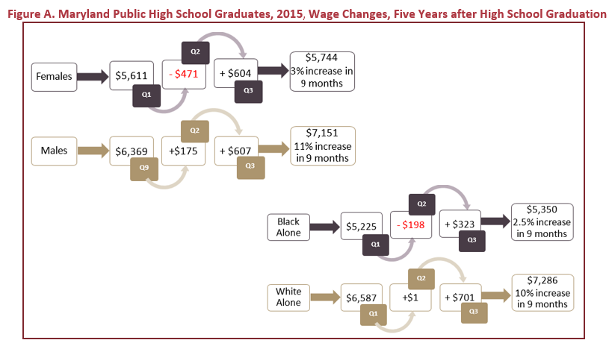


Career Preparation Expansion Act, Supplement
MLDS Center. (2024). Wage Visibility and Median Quarterly Wage Patterns in the First Two Fiscal Quarters of COVID-19: A Supplement to the Annual Career Preparation Expansion Act Report on the Workforce Outcomes of Maryland Public High School Graduates to the Governor and General Assembly. Baltimore, MD: Maryland Longitudinal Data System Center.

Slide 17
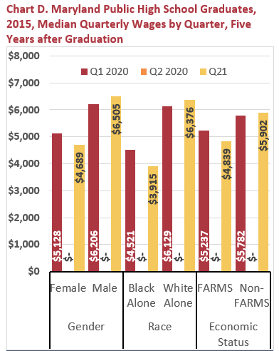
Career Preparation Expansion Act, Supplement
For high school graduates who exited in April to June 2020 and returned in July to September 2020 . . .
  Males, Whites and Non-FARMS had median quarterly wages increase ~$250
  Females, Black and FARMs had median quarterly wages decrease ~$500
MLDS Center. (2024). Wage Visibility and Median Quarterly Wage Patterns in the First Two Fiscal Quarters of COVID-19: A Supplement to the Annual Career Preparation Expansion Act Report on the Workforce Outcomes of Maryland Public High School Graduates to the Governor and General Assembly. Baltimore, MD: Maryland Longitudinal Data System Center.

Slide 18
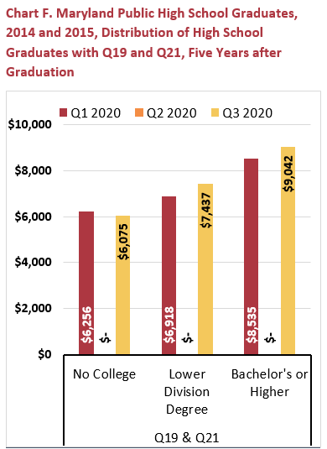
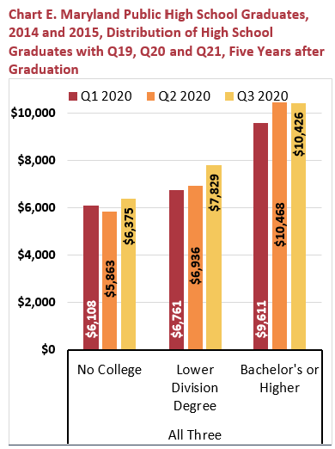
Career Preparation Expansion Act, Supplement
Graduates with college degrees increased median quarterly wages $1,000 (no Q2 exit) & $500 (exited Q2)
Graduates without college degrees increased median quarterly wage of $200 (no Q2 exit) and decreased of $200 (exited Q2)
MLDS Center. (2024). Wage Visibility and Median Quarterly Wage Patterns in the First Two Fiscal Quarters of COVID-19: A Supplement to the Annual Career Preparation Expansion Act Report on the Workforce Outcomes of Maryland Public High School Graduates to the Governor and General Assembly. Baltimore, MD: Maryland Longitudinal Data System Center.

Slide 19
Research Branch Priorities, 2024-2025
Priority 1: In-Depth Statistical Analyses to Support Causal Inference and Inform Policy Equity in pathways from HS to College to WF Workforce outcomes for DJS-involved students Critical WF areas (e.g., teaching; STEM; healthcare; social work; cyber/tech) & production of students to meet these needs Education and labor outcomes for students in out of home placement Examine cross-system involvement (DHS and DJS) and outcomes (+) The link between correctional education and labor participation (+) Students who have some college experience but leave without a degree (+) Homelessness and mobility/churn in college and the workforce (+) Outcomes for students served by community schools (+) Outcomes for students served by community support hubs (Partnership with the MCCCS) (+) Causal designs to examine interim Blueprint implementation and outcomes |  | Priority 2: Methodological Documentation Equity in Data Science Using Census data to examine disadvantage Intersectionality in personal characteristics predicting outcomes (+) Using disability codes once received Planned In-Progress Suggested

Slide 20
Diversifying the Teacher Workforce

Slide 21
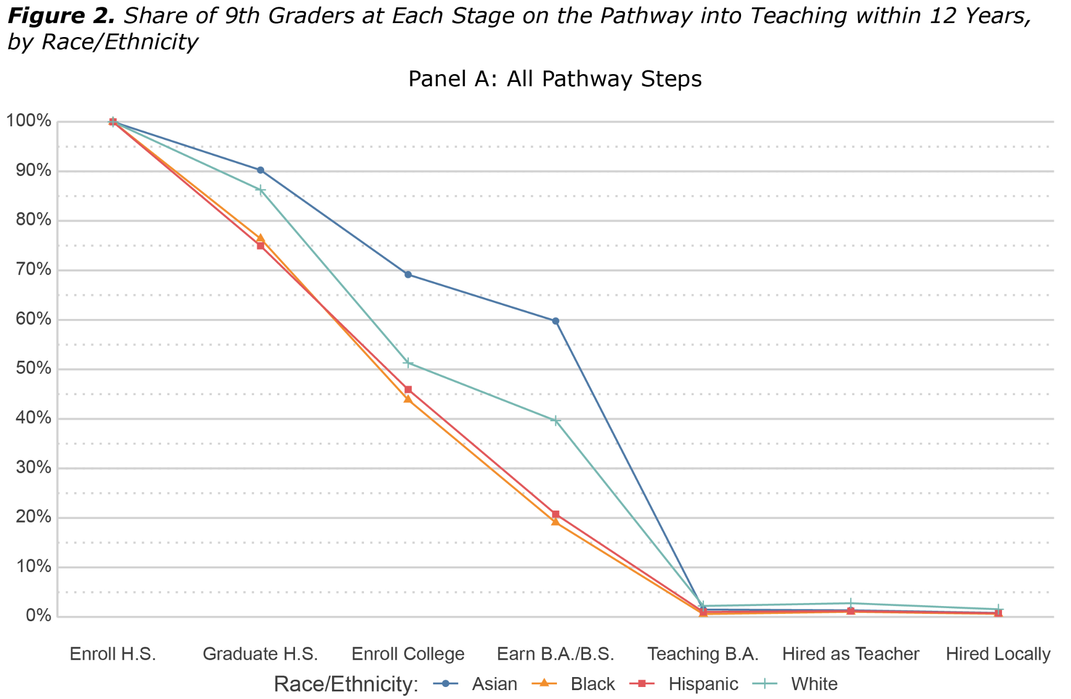
Teaching Pathways from 9th Grade

Slide 22
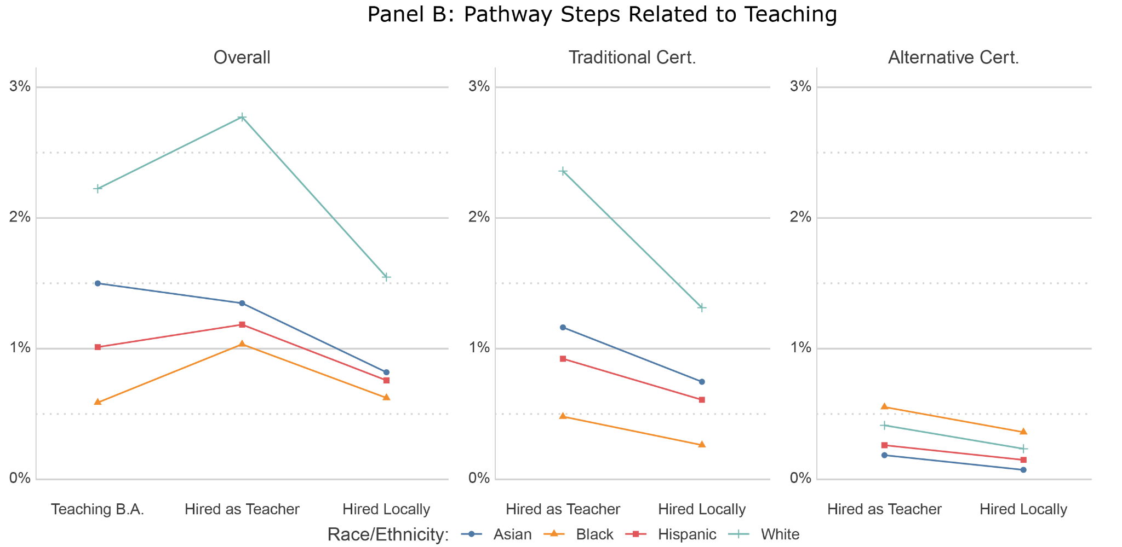
Teaching Pathways

Slide 23
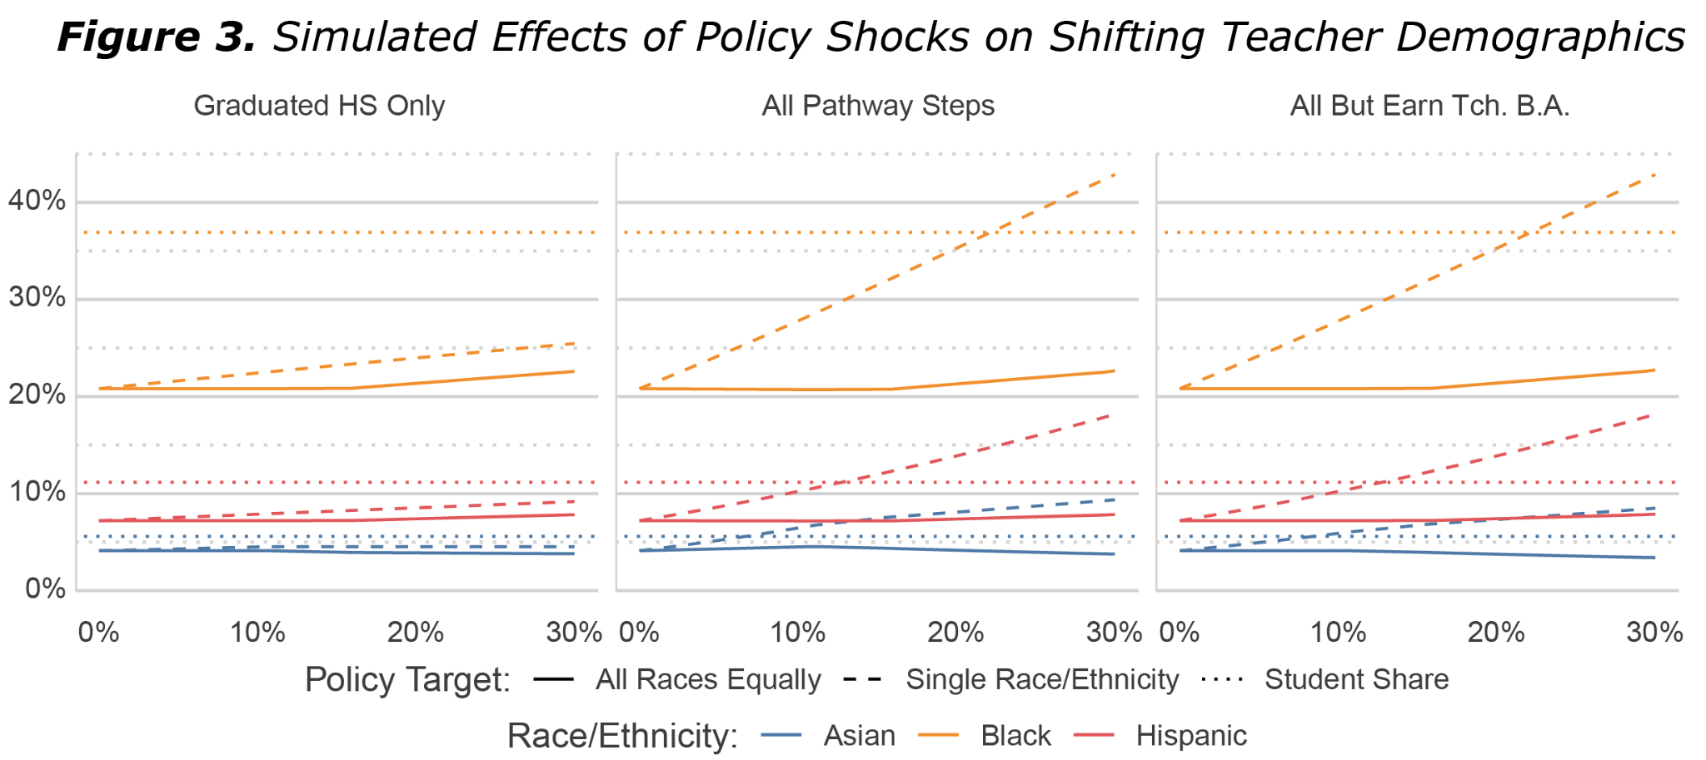
Simulated Policy Shock

Slide 24
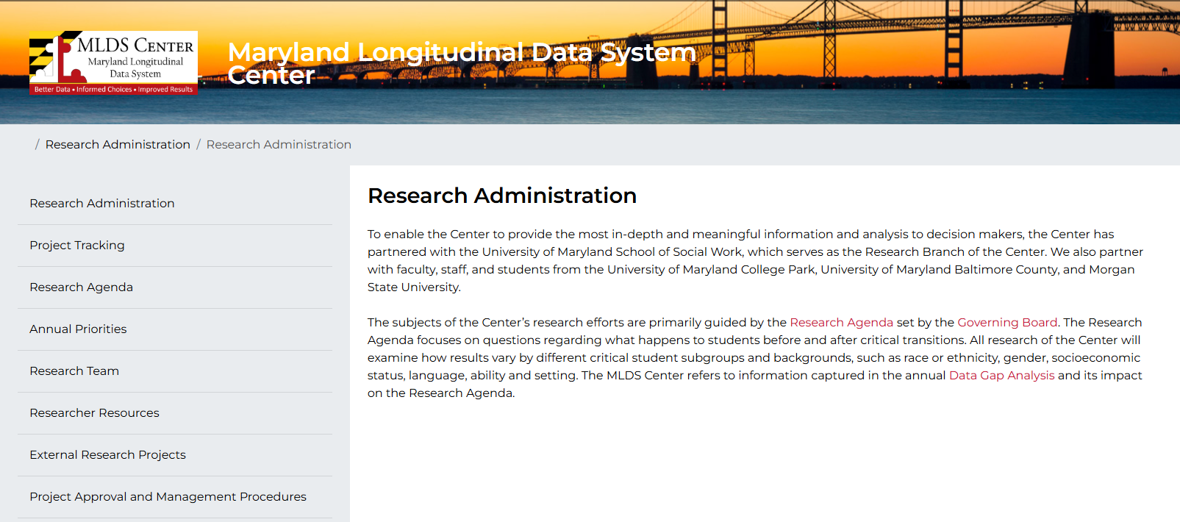
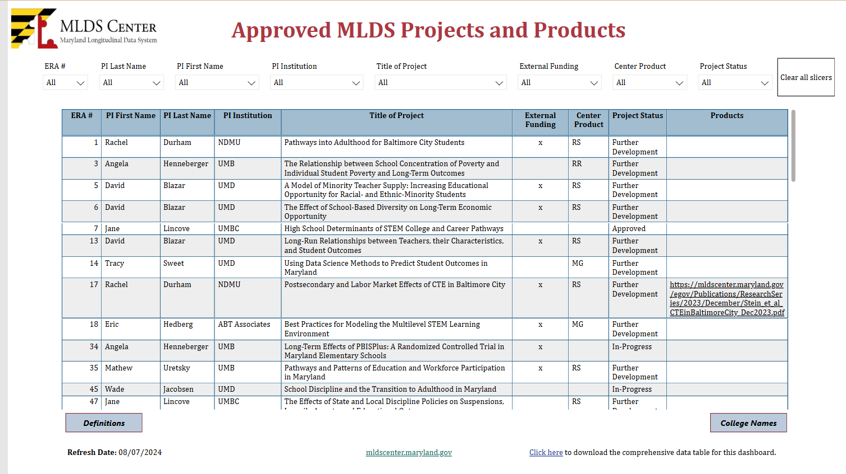
Project Applications and Updates

Slide 25

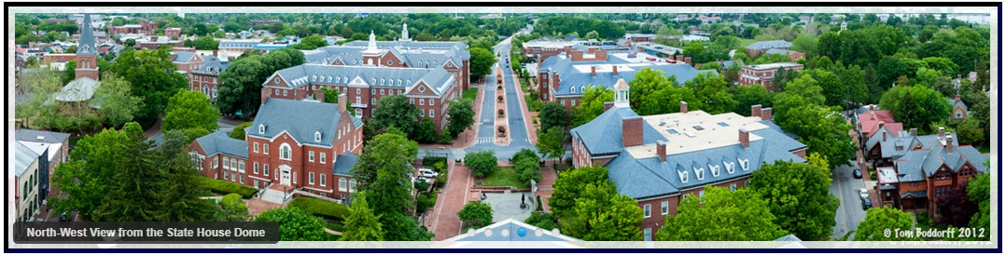
Legislative Session 2025
HB611: / SB713 Institutions of Higher Education - Mandatory Disclosures for New and Prospective Students (Informed Enrollment Act) College Scorecard
HB 298: Maryland Higher Education Commission - Demographic Data Collection - Parental Status
House Bill 479 - Maryland Higher Education Commission - Academic Program Approval - Revisions
House Bill 725 - Institutions of Higher Education – Dually Enrolled Students – Alterations
FY 26 Budget

Slide 26
Data Inventory Proposed Additions
Non Degree Teacher Candidate System (NTS)
  SSN, ID Number Type, Local Campus Student ID, SASID, Gender, US Citizenship, Hispanic/Latino, Race (5)
  Collection Term, Collection Year, Sub-Campus Code, Degree Date, Degree Sought, Program Taxonomy, First Major Link, Cumulative GPA, Cumulative Native Credit Hours Earned, Cumulative Credit Hours Awarded, Prior Degree Flag, Entry Term, Entry Year, Reverse Transfer Flag, Credit Hours Required to Earn Award, Teacher Candidate
Action Item: Board Vote

Slide 27
Data Inventory Proposed Additions
Early Intervention and Special Education Services
  Birth Date, Gender, Hispanic/Latino, Race (5), Local Student ID, SASID, Last Name, First Name, Middle Name, Age, Grade, Service-School County, Service-School Number, Residence-School County, Residence-School Number, LSS, Report School, Submission Year
  Limited English Proficiency, Medical Assistance, Disability, Least Restrictive Environment, Extended School Year, Projected Category of Exit, Exit Reason, Assistive Technology Devices, Transportation, Eligibility, Early Childhood Transition, Reason for Delay Indicator 11, Reason for Delay Indicator 12, Initial Eligibility Age Group, Alternate Assessment, Parent Consent for Alternate Assessment, Alternate Standards, Parent Consent for Alternate Standards, Parent’s Native Language, Blind or Visually Impaired, Deaf of Hearing Impaired

Slide 28
Data Inventory Proposed Additions
Early Intervention and Special Education Services
  Dates: IEP Team Meeting, Evaluation, Projected Date of Exit, Exit Date, Functional Behavioral Assessment, Behavioral Intervention Plan, Initial IEP Development, Parent Consent for Initiation of Services, Initial IEP is in Effect, Parent Consent for Initial Evaluation, Initial Evaluation, Parent Consent Continue Early Intervention Services through an IFSP at age 3, LSS was Notified of Parent Decision to Request Services through an IEP, Extended IFSP Services Ended
Action Item: Board Vote

Slide 29
Data Inventory Proposed Additions
High School Data Collection
  Academic Success, Math Mastery - Course Grade, Math Mastery - ALG1 Proficiency, ELA10 - Proficiency, CCR Status - MSDE Computed, CCR Standard, Apprenticeship - Currently in program, Apprenticeship - Hours accrued
Department of Public Safety and Correctional Services
  Gender, Race/Ethnicity
Maryland Health Occupation Boards and Commissions
  Hispanic
Action Item: Board Vote

Slide 30
Data Inventory Proposed Additions
Educators Rising
  First Name, Last Name, High School, Participation Date, Date of Birth
Action Item: Board Vote

Slide 31
Data Inventory Proposed Temporary Additions
High School Pathways
  Temporary ID, Student ID, Date of Birth
  Academic Year, Destination School Code, Destination School Program, Grade Code, Current School Code, Rank Type, Requires Special Handling, Preference to School 1, 2, and 3, Composite Score, Composite Score Estimate, Ordering, Zoned Middle School ID, Zoned High School ID, Choice Number, Rank, Placement Outcome, Decision Code, Description of Placement Outcome
Action Item: Board Vote

Slide 32
Old Business

Slide 33
Census Bureau Data Sharing - Participation with Post Secondary Education Outcomes Explorer (PSEO)
Recommendation from the Board 9/13/2024:
The Center has learned that MHEC is going to take the lead on partnering with PSEO. The MLDS Center should defer to MHEC as the state's higher education authority. MLDS Center should provide an update on MHEC’s progress at the December Governing Board meeting.

Slide 34
Research Agenda Review Process: Update
February- March 2025
April - May 2025
June 2025
FY2026
Internal Staff Meetings
RPB Feedback
Governing Board Review
Implementation of Process
Policy for Review
Procedure for Review
Present Policy and Procedure for Feedback
Present as Informational at Governing Board meeting
Conduct Review and Collect RPB Feedback January to May 2026
Present Revisions at June Governing Board Meeting
Revised Agenda Implemented: July 1, 2026

Slide 35
AIB MOU Overview
MLDSC and AIB entered into an interagency agreement to govern the use of the MLDS by AIB for their required Outcome Measures analysis.
The MLDSC will:
  Provide system access to AIB staff;
  Develop data sets and update them annually; and
  Provide subject matter expertise and input.
The AIB staff will:
  Conduct the Outcome Measures analysis;
  Support the Center in working to collect data not in the MLDS that are needed for Outcome Measures;
  Communicate with and receive feedback from RPB; and
  Assume responsibility for dissemination of their analyses.
Unique aspects:
  Not a project
  Single sector analyses are permitted

Slide 36
Data Security and Safeguarding Plan
Contractor has been selected to:
Conduct a comprehensive review of:
  The DSSP and related documents;
  The role of DoIT’s enterprise system management;
  The Center’s current system security procedures and operations; and
  The State of Maryland Information Technology Security Manual; and
Revise the DSSP to be up-to-date, include current best practices, and be in full alignment with DoIT requirements and the IT Security Manual.

Slide 37
New Business

Slide 38
Closed Session

Slide 39
Closing
Next Meeting
June 13, 2025 - 9 a.m. to 12 p.m.

