Slide 1
MLDS Data Governance Advisory Board Meeting
April 16, 2026

Slide 2
MLDS Data Governance Advisory Board Meeting
Please note, this meeting is being recorded and using Gemini.
April 16, 2026

Slide 3
Agenda
March Governing Board Meeting
Charter Review
Legislative Updates
Data Collection Calendars
Data Collection Updates
Overdue Files
Other Business

Slide 4
March Governing Board Agenda
Welcome
Bylaws
Center Output
Legislation
Data Inventory
Project Applications and Updates
Old Business
New Business
Closing

Slide 5
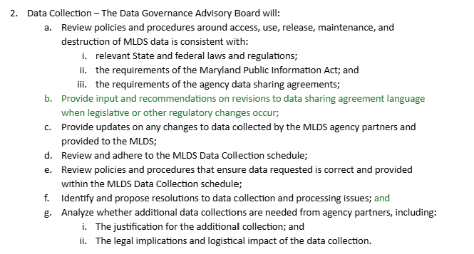
Charter Review - Data Collection

Slide 6
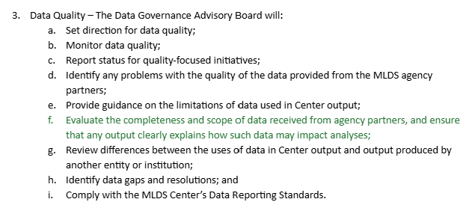
Charter Review - Data Quality

Slide 7
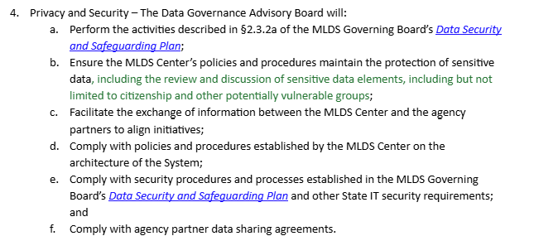
Charter Review - Privacy and Security

Slide 8
Legislative Updates
HB0293/SB0056: MLDSC - External Data Sharing With Third-Party Data Centers for Multistate Reporting - Authorization
HB 293 - Passed and Signed - Chapter 100
SB 56 - In House - Passed and Signed - Chapter 101
Other Legislation
HB 264 - Maryland Data Privacy and Protection Act - Passed
HB 538 - Institutions of Higher Education - Mandatory Disclosure for New and Prospective Students -Failed
HB 1305 - State Child Welfare System - Reporting - Passed
HB 297 - Adult Education - High School Diploma Pathways - MDiplomaWorks Pathway - Passed

Slide 9
Data Collection Calendars
Draft calendars for 2026-2027 to be reviewed
Review due May 1st
Present at June Governing Board Meeting

Slide 10
Overdue Files
2026 Correctional Education
Workforce Wages 2025 Quarter 4

Slide 11
Other Business
Generative AI Training for MSDE Staff (in person)
Monday, April 27th 11:00-12:00
Wednesday, April 29th 11:00-12:00
The State of Maryland offers free, asynchronous training​ on a range of AI topics through InnovateUS

Slide 12
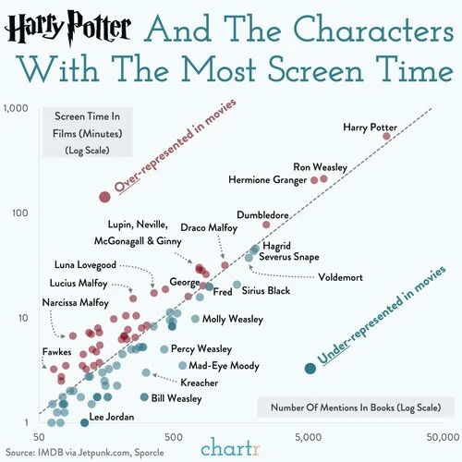
Agency Partner Updates

Slide 13

2026 Meeting Dates
February 19, 2026 ✔
April 16, 2026 ✔
May 21, 2026
August 20, 2026
October 15, 2026
November 19, 2026

