Slide 1
MLDS Data Governance Advisory Board Meeting
February 19, 2026

Slide 2
MLDS Data Governance Advisory Board Meeting
Please note, this meeting is being recorded and using Gemini.
February 19, 2026

Slide 3
Agenda
December Governing Board Meeting
March Governing Board Agenda
Charter Review
Legislative Updates
Data Collection Calendars
Data Collection Updates
Repealing 24-702(c)
Overdue Files
Other Business
  PSEO Update

Slide 4
December Governing Board Meeting
Center Output
Data Inventory
Annual Report - Review and Approval
Data Security and Safeguarding Plan - Review and Approval
December Report Highlights
Project Applications and Updates
Old Business
  Legislative Proposal
  2024 Annual Report Recommendations - Follow-up
New Business
Closing

Slide 5
March Governing Board Agenda
Bylaws
Center Output
Legislation
Data Inventory
Project Applications and Updates
Old Business
New Business
Closing

Slide 6
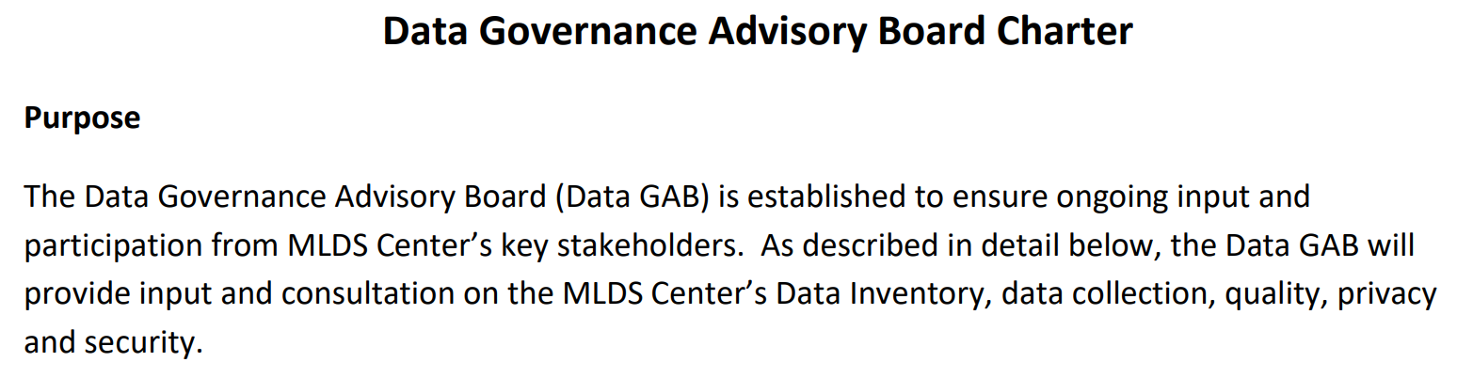
Charter Purpose

Slide 7
Charter Review
Data Inventory
Data Collection
Data Quality
Privacy and Security

Slide 8
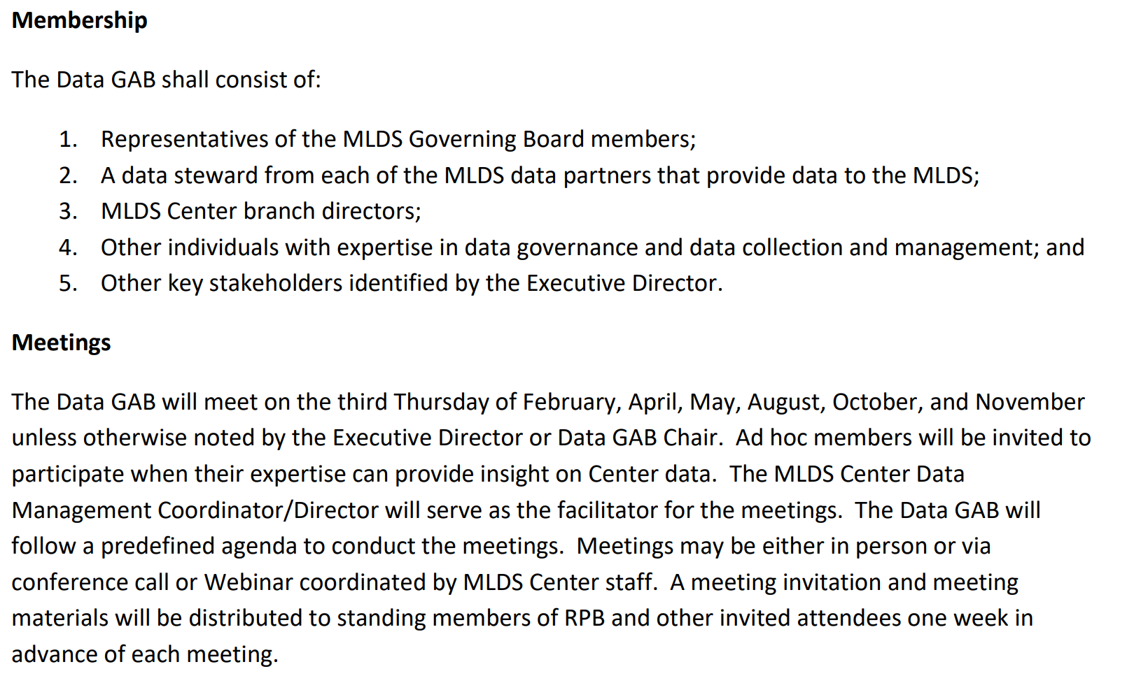
Charter Membership and Meetings

Slide 9
Legislative Updates
HB0293/SB0056: Maryland Longitudinal Data System Center - External Data Sharing With Third-Party Data Centers for Multistate Reporting - Authorization
  First hearing in Senate 2/4
  Amendment made to add approval/consultation by DoIT
HB0264: Maryland Data Privacy and Protection Act of 2026
  Need to designate a Privacy Officer
  Requirements around data collection and retention

Slide 10
Data Collection Calendars
Draft calendars for 2026-2027 to be reviewed
Review due May 1st
Present at June Governing Board Meeting

Slide 11
Data Inventory: Approved December 2025
Occupational and Professional Licensing (31)
  12 identity-related elements
  Employer Tradename, Employment Address 1, Employment Address 2, Employment State, Employment Zip Code, Employment County Code
  Issuing Board/Commission Entity, Issuing Board/Commission Entity Name, License Type, License Type Name, License Number, Initial License Date, License Renewal Issue Date, License Expiration Date, Active/Inactive Status
  Exam Name, Exam Result, Certified from another State

Slide 12
Data Inventory: Proposed Additions
Maryland State Department of Education
  Seal of Biliteracy, Seal of Biliteracy Awarded

Slide 13
Data Inventory: Proposed Additions
Apprenticeship Maryland Program Data Briefing
  Gender, US Citizenship, Hispanic/Latino, Race Categories, ID Number Type, SASID, Local Campus ID, SSN
  Collection Term, Collection Year, Sub-Campus Code, Degree Date, Degree Sought, Program Taxonomy, First Major Link, Cumulative GPA, Cumulative Native Credit Hours Earned, Cumulative Credit Hours Awarded, Prior Degree Flag, Entry Term, Entry Year, Reverse Transfer Flag, Credit Hours Required to Earn Award

Slide 14
Repealing 24-702(c)
The linkage of student data and workforce data for the purposes of the Maryland Longitudinal Data System shall be limited to no longer than 20 years from the date of latest attendance in any educational institution in the State.

Slide 15
Overdue Files
2026 Juvenile Delinquency Records (DJS)
2026 Special Education (MSDE)
2026 Microsoft
2026 Apprenticeship (Labor)
2026 WTRS (MHEC)

Slide 16
Other Business
Post-Secondary Employment Outcomes (PSEO) Update
Director of Information Technology position opening at MHEC

Slide 17

Agency Partner Updates

Slide 18

2026 Meeting Dates
February 19, 2026 ✔
April 16, 2026
May 21, 2026
August 20, 2026
October 15, 2026
November 19, 2026

